Slide 1
Loan Eligibility
ICS 352-50 - Fall 2023
Professor Siva Jasthi
Dara Tourt, Dizia Begum, Abdellah Afellah, Claire Evans, Alex Jones

Slide 2


INTRODUCTION
Approving loans is a process that involves a multitude of info from
both the customer and the lender. We used a dataset from loan
processing to train a Machine Learning model to predict if a
loan is approved or denied based on the info from the client.
The dataset used for this project was obtained on Kaggle
Upon download the data contains:
12 Independent Variables
1 Dependent Variable (Loan Status Y/N)
615 Rows

Slide 3
Machine Learning
01
02
03
04
Identify data
Preprocessing Data
Feature Selection
Model Training
Exploration & Visualization
Cleaning & Normalization
Impactful Features
Split data & train
05
Model Scoring
Test model & score
3

Slide 4
Data Exploration And Visualization
Count plot of Categorical Variables
Histogram of Continuous Variables
Scatterplots of Continuous Variables
Boxplots
Heat Map of Correlation
4

Slide 5
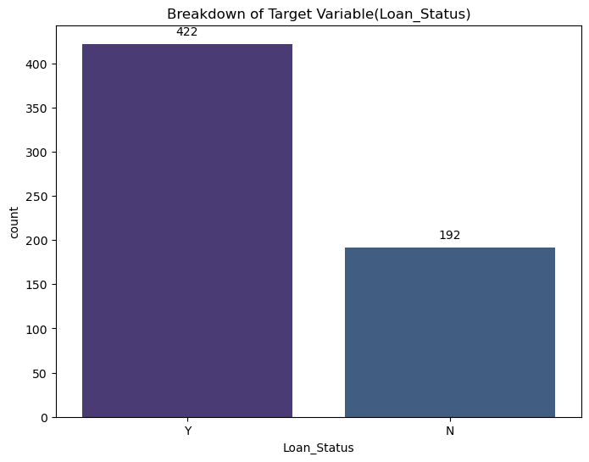
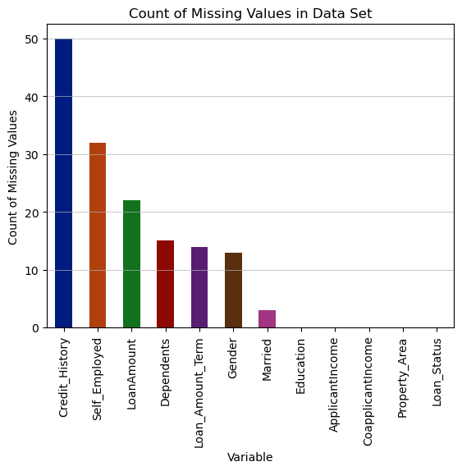
DATA VISUALIZATION breakdown of target variable & missing values
More Loans approved (69%) than denied (31%)

Slide 6
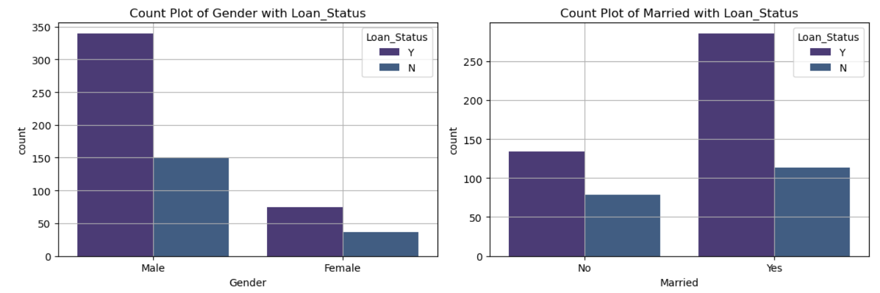
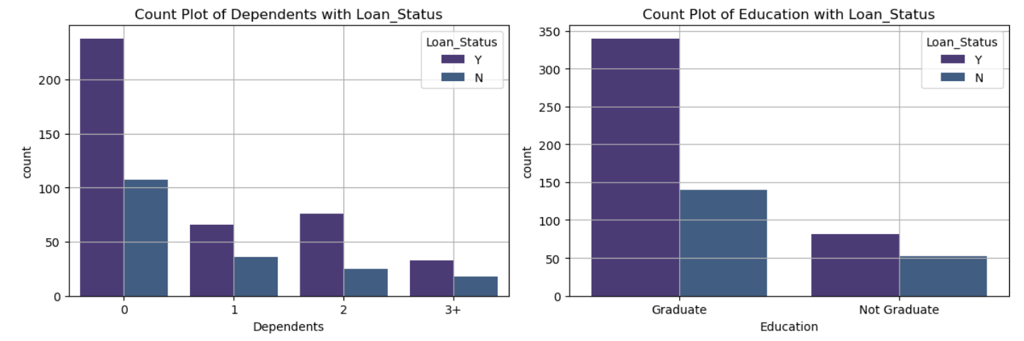
DATA VISUALIZATION Predictor Categorical Variables by Target Variable
Similar approval vs. denial rates across different categories (2 to 1)
Most frequent attributes of Applicants:
Male
Married
Graduate
Zero Dependents

Slide 7
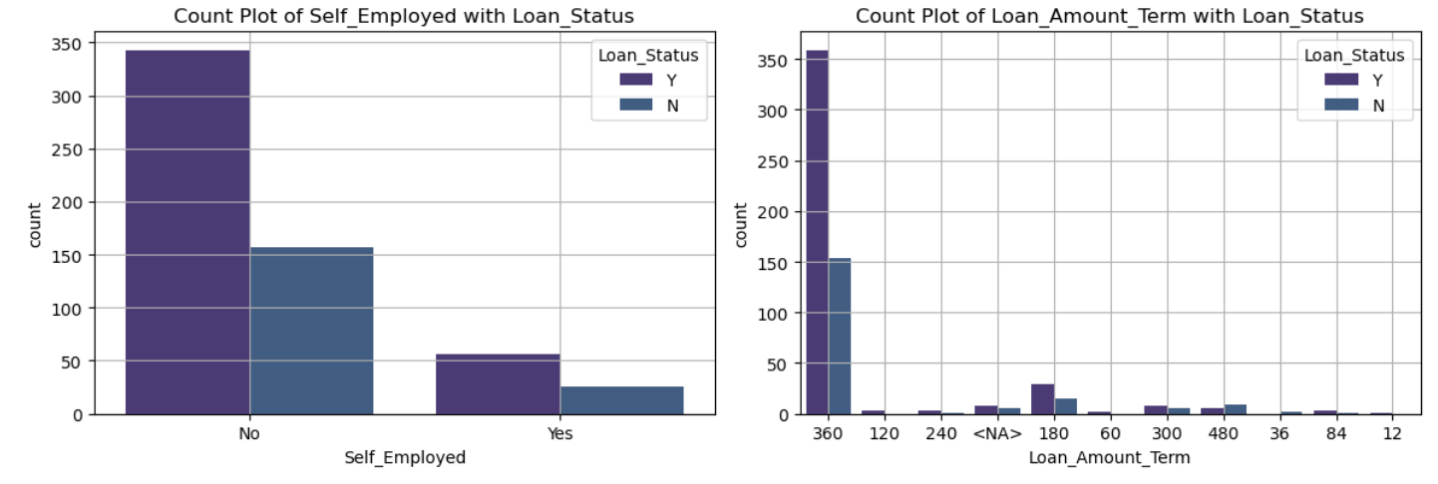
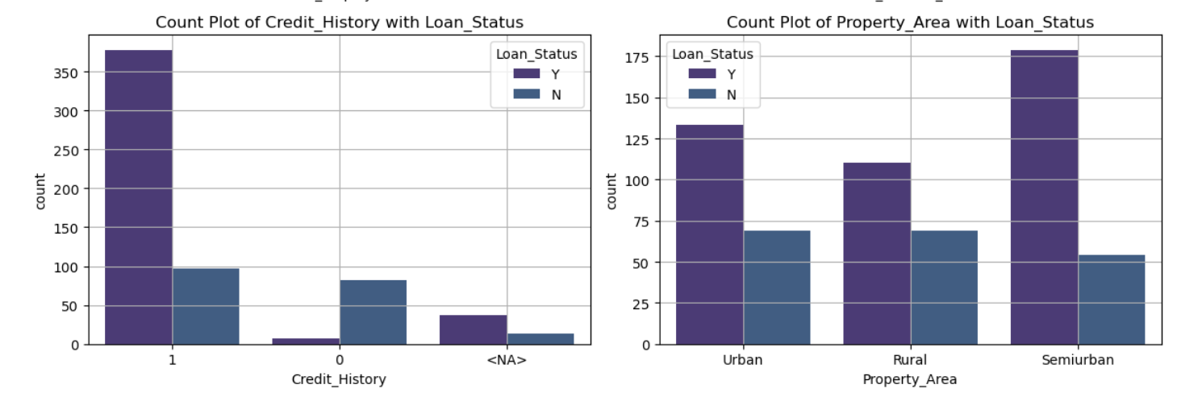
DATA VISUALIZATION Predictor Categorical Variables by Target Variable - Cont.
Similar approval vs. denial ratio.
Most frequent attributes of Applicants:
Not Self-Employed
Have Credit History
Semiurban Property
Loan Term of 30 Years

Slide 8
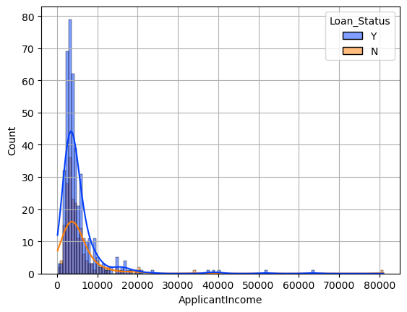
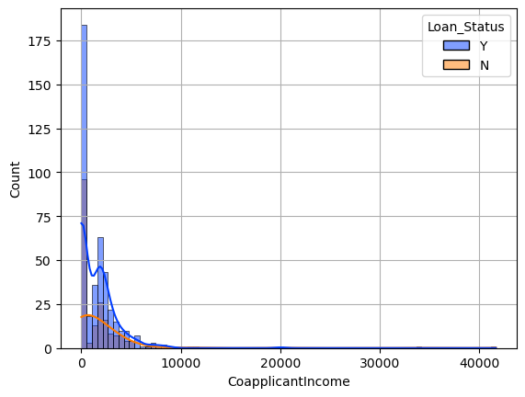
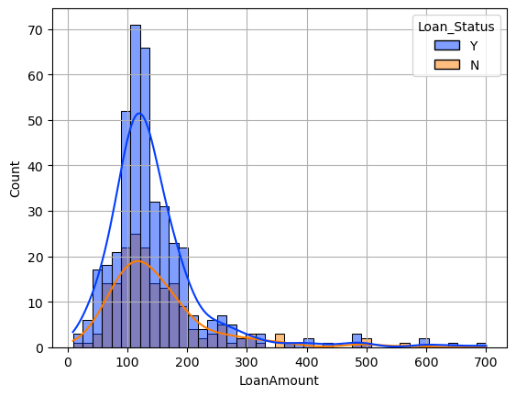
DATA VISUALIZATION distribution & shape of continuous variables
Not Normally Distributed
Right skewed with long tail

Slide 9
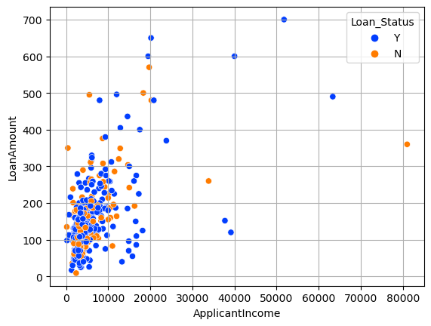
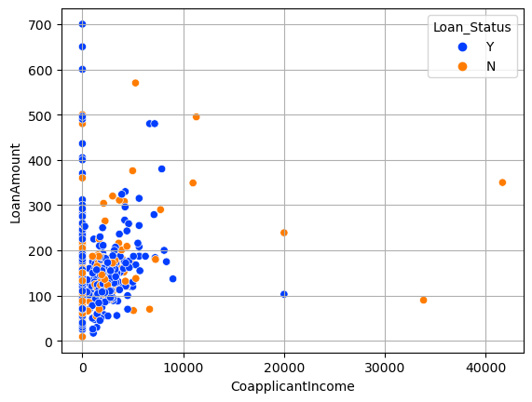
DATA VISUALIZATION Relationship - Loan Amount and Applicant and Co-Applicant Income
Positive relationship with Loan Amount and Applicant Income – In general, the higher the Income, the higher
the Loan Amount.
Positive relationship with Loan Amount and Co-Applicant Income – In general, the higher the Co-Applicant Income, the higher the Loan Amount.

Slide 10
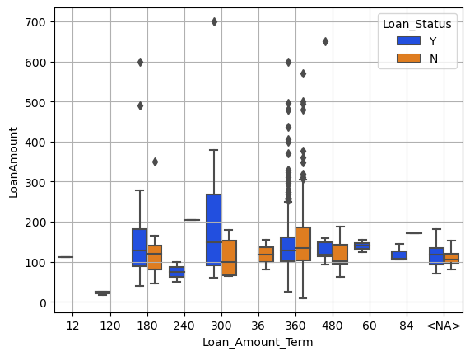
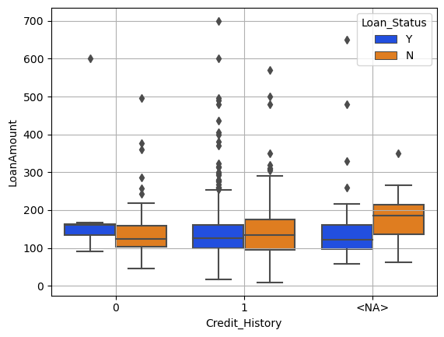
DATA VISUALIZATION Relationship - Loan amount with other variables
Visually no significant differences observed across the groups

Slide 11
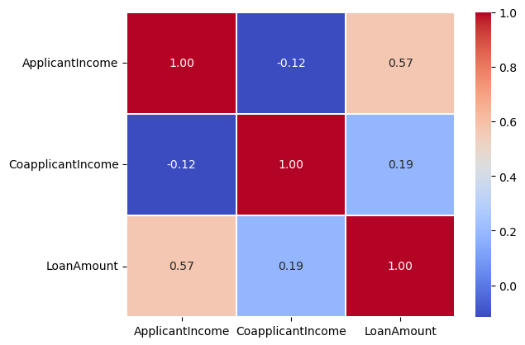
DATA VISUALIZATION Correlation Heat Map of Continuous Variables
Loan Amount and Applicant Income are moderately correlated with a value of 0.57

Slide 12
Data Cleaning and preprocessing
Null Values
Transformations
Outliers
Scaling

Slide 13
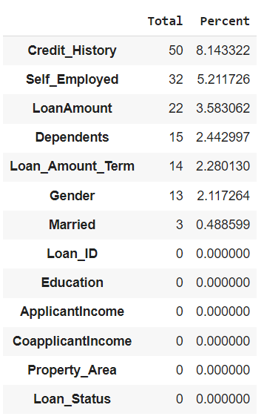
Data Cleaning/Pre-Processing: Null Values
Median
LoanAmount
Mode
Gender
Loan_Amount_Term
Dependents
Married
Self_Employed
0
Credit_History

Slide 14
Data Cleaning/Pre-Processing: Transformations
Convert ordinal feature from object to integer: Dependents
One-hot Encode nominal feature: Property_Area.
Convert binary categorical features from object to integer: Gender, Married, Education, Self_Employed, Loan_Status.

Slide 15
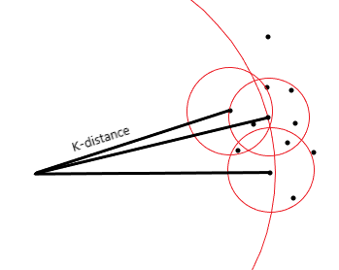
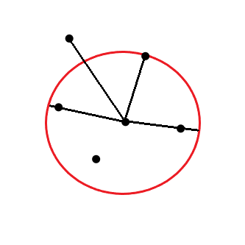
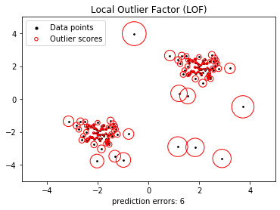
Data Cleaning/Pre-Processing: Outliers
Libraries Used:
scikit-learn
Methods Used:
LocalOutlierFactor()
Local Outlier Factor (LOF) Algorithm
LOF computes the local density deviation of a data point with respect to its neighbors.
Assigns an anomaly score based on the ratio of the average local density and the point’s local density.
Anomaly score: LOF ~ 1 means similar data point, LOF < 1 means inlier, and LOF > 1 means outlier.

Slide 16
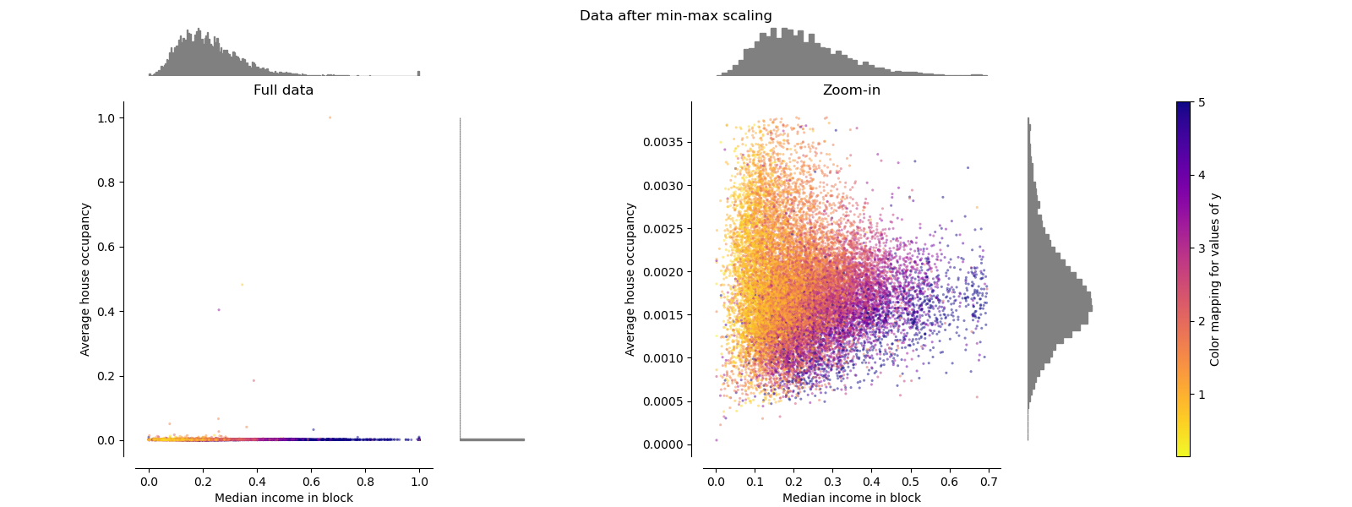
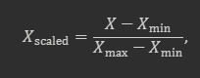
Data Cleaning: Scaling
Libraries Used:
Pandas
scikit-learn
Methods Used:
MinMaxScaler()
The MinMaxScaler() is a function used for feature scaling.
It is calculated as:
It scales each feature individually to make all values fall within a range (typically between zero and one).
Example of a scaling transformation from scikit-learn LINK
16

Slide 17
Benefits of Outlier Removal/Feature Scaling
Prevent Overfitting
Better Performance
Reliable Evaluation Metrics
Outlier Removal
Feature Scaling
Equal Importance
Faster Convergence
Improves Distance Based Models
Ensures Normal Distribution

Slide 18

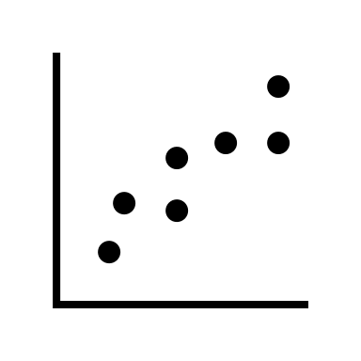

Problem definition
Loan Eligibility is a classification problem.
This can be determined through the dependent variable, loan status.
The options for loan status are Y or N, which correspond to the approval or rejection of the loan based on the data in the independent variables.
This prediction of a label as a result is indicative of a classification.
There are many options for models regarding classification contained in the Sci-Kit Learn library.

Slide 19
MODEL TRAINING
Independent Features
Significant Feature Selections
Features Separation
Data Split
Gender
Married
Dependents
Education
Self_Employed
ApplicantIncome
CoapplicantIncome
LoanAmount
Loan_Amount_Term
Credit_History
Rural_Area
Urban_Area
Semiurban_Area
ApplicantIncome
CoapplicantIncome
LoanAmount
Loan_Amount_Term
Credit_History
Semiurban_Area
Case 1:
X= All independent variables
Y= a Loan_Status feature(Dependent Variable)
Case 2:
X= Only significant Independent variables
y= a Loan_Status feature(Dependent Variable)
Training = 80%
Testing = 20%
Random State = 42

Slide 20
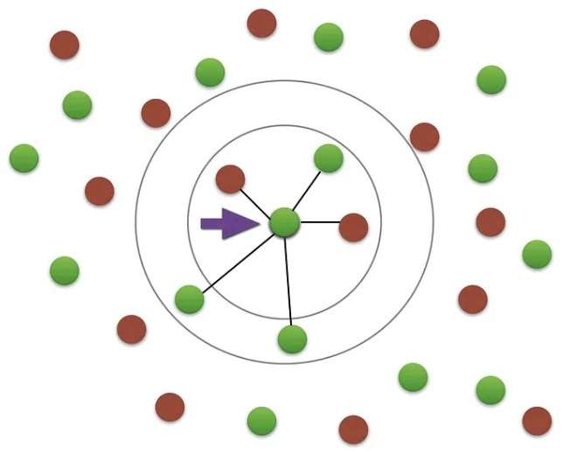
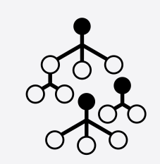
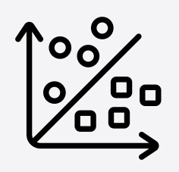
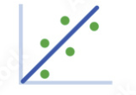
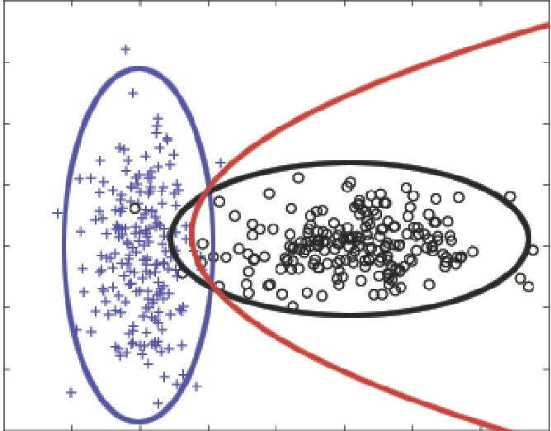

Model Selection
Machine Learning Algorithms
K-Nearest Neighbour (KNN) | Feature similarities/Distance metrics
Random Forest | Classification and regression
Support-vector machines | Hyperplane
Regression analysis | Relationship Quantification
Gaussian Naïve Bayes | Probabilistic Classification
Decision Tree | Flowchart-like
20

Slide 21

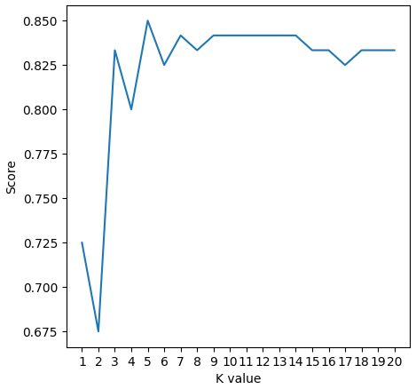
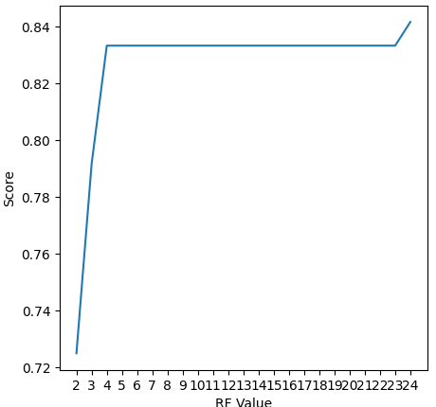
Model Selection Parameter

Slide 22
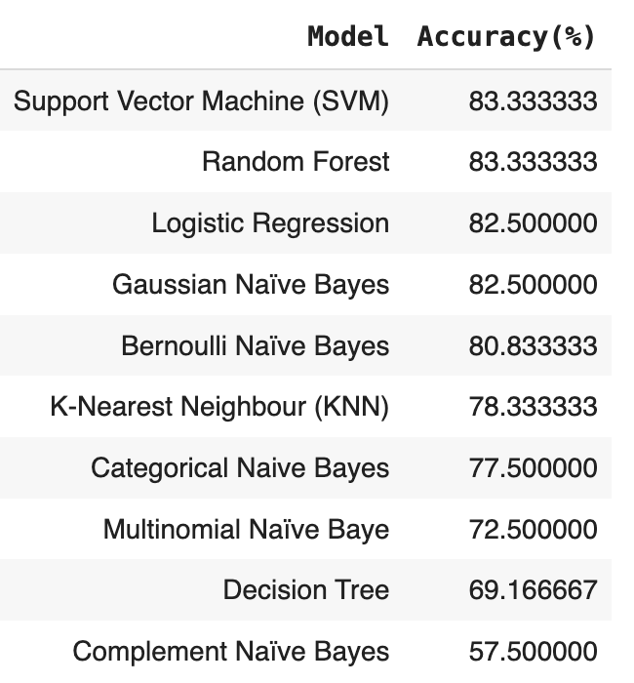
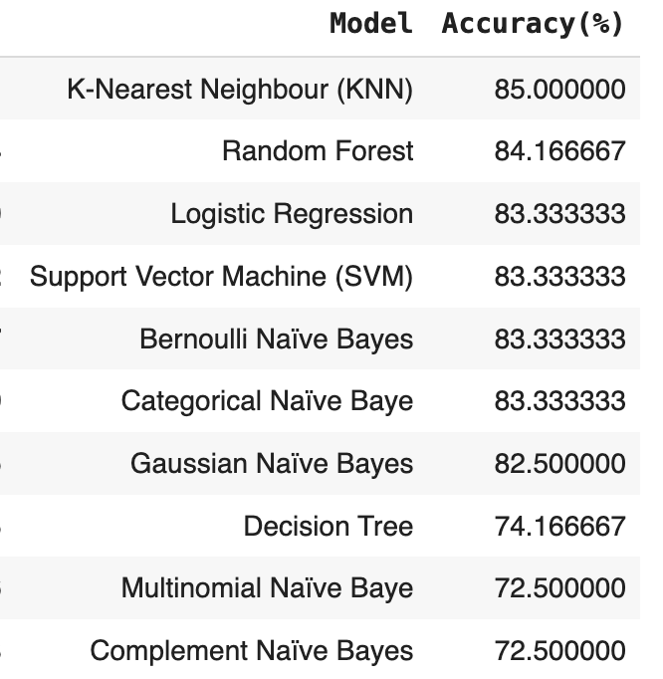
Model SCORING
With All Independent Features
With Significant Features

Slide 23
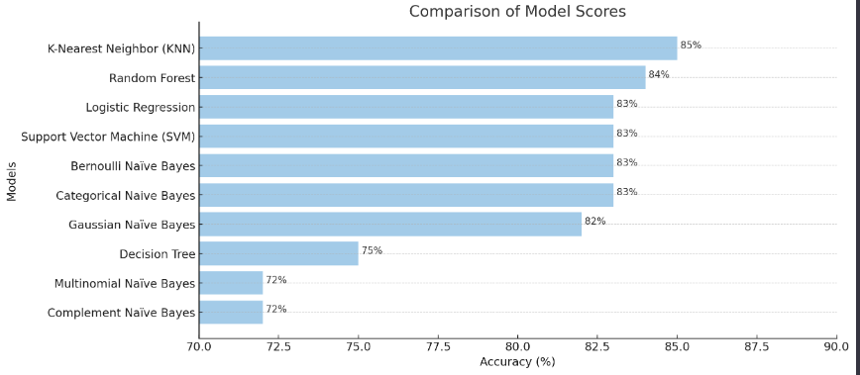
Final Models Scores

Slide 24
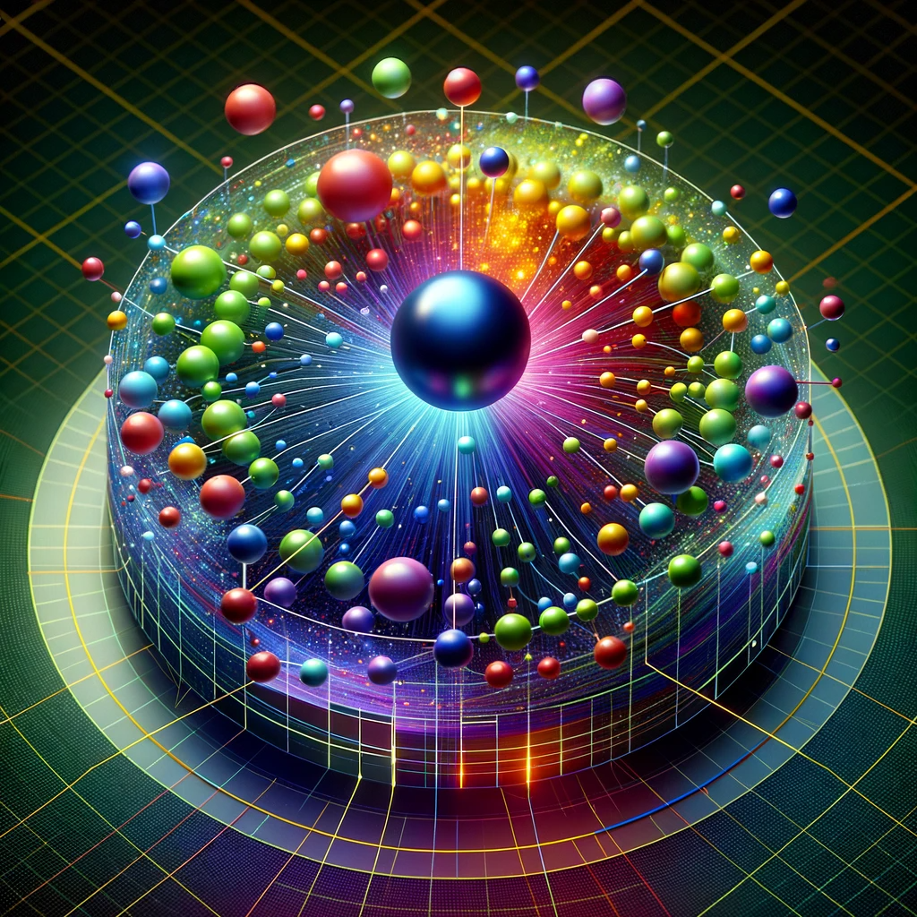
K-Nearest Neighbor model
The Best Model: KNN with K value = 5
Accuracy Score: 85%

Slide 25
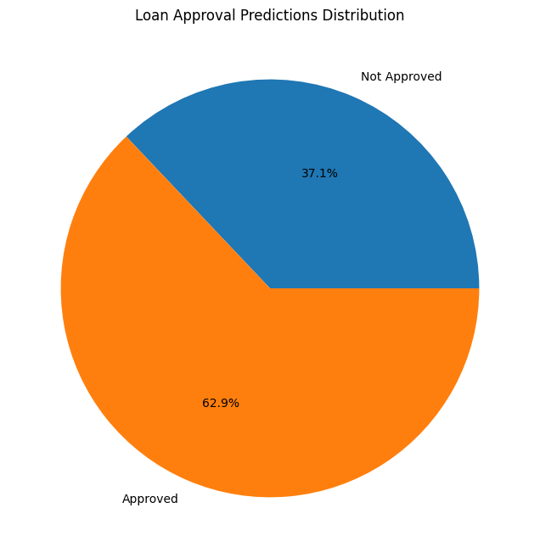
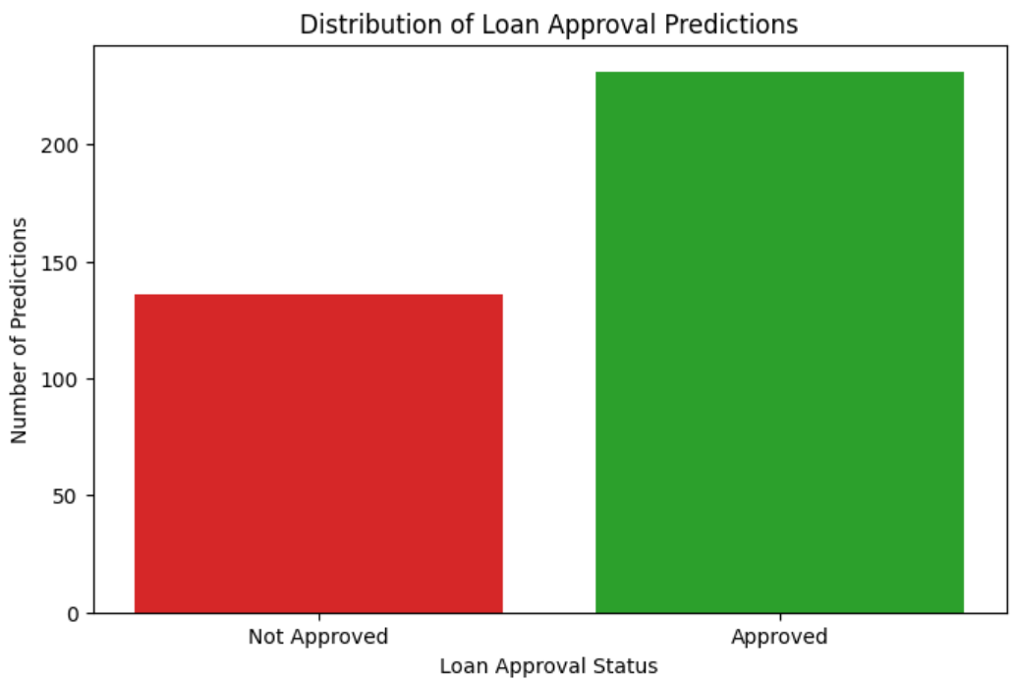
Model Deployment and Testing

Slide 26

CONCLUSION
Through extensive work cleaning data and training models we were able to produce a model that can predict loan eligibility based on the best features. The resulting model produces an accuracy score of 85%.
6
This model could be a useful tool in assisting with the approval of loans in industry. An additional benefit has been cutting details out of the process to streamline loan application.
12
50% REDUCTION!
The experience gained in this project has industrial merit and provided a much-needed insight into the world of Machine Learning.

Slide 27
THANK YOU

